Slide 1
High Dynamic Range Imaging and Images

Slide 2
Primary References
[1] Paul E. Debevec and Jitendra Malik. “Recovering high dynamic range radiance maps from photographs.” In ACM SIGGRAPH 2008 classes (SIGGRAPH '08). ACM, New York, NY, USA, Article 31, 10 pages.
[2] Paul E. Debevec’s web pages on HDR: http://ict.debevec.org/~debevec/Research/HDR/
[3] Raanan Fattal, Dani Lischinski, and Michael Werman. “Gradient domain high dynamic range compression.” In Proceedings of the 29th annual conference on Computer graphics and interactive techniques (SIGGRAPH '02). ACM, New York, NY, USA, 249-256.

Slide 3
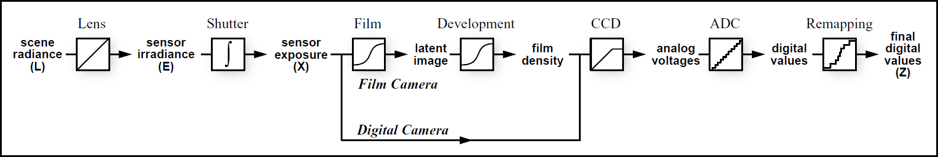
The Process of Imaging
Image Acquisition Pipeline. From scene radiance to pixel values for both film and digital cameras. Usually all quantities are unknown except for the pixel values and the exposure time. Unknown nonlinear mappings include exposure, development, scanning, digitization, and remapping.
This page ref: [1]

Slide 4
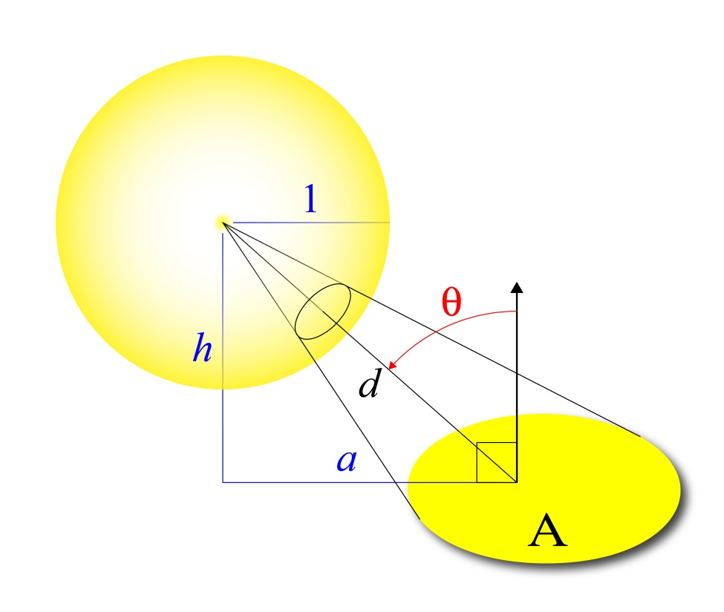
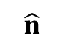
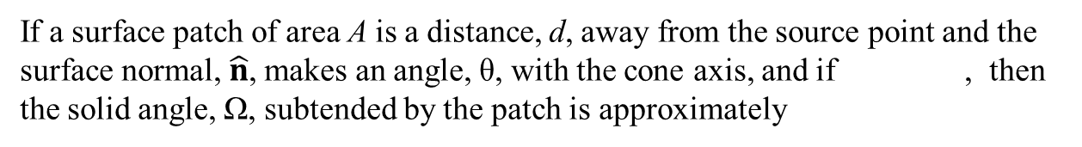
The Process of Imaging — Radiometry
Solid Angle: The area traced out on the surface of a unit sphere by a cone with vertex on the center of the sphere.
Units: steradians.
The total solid angle of a single point in space is 4π steradians.

Slide 5
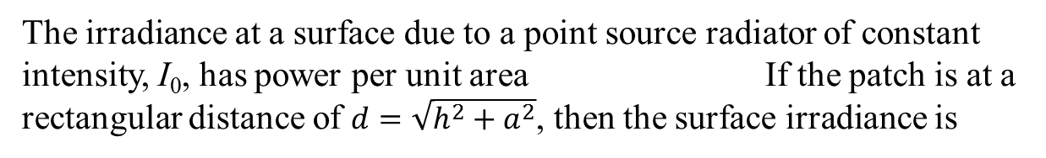
The Process of Imaging — Radiometry
L – radiance: the amount of light emitted from a surface; the power per unit foreshortened area emitted into a unit solid angle. Units: (watts/meter²)/steradian.
E – irradiance: the amount of light impinging on a surface; the power per unit area. Units: watts/meter². In the case of imaging, the surface being irradiated is the camera’s image plane.

Slide 6
High Dynamic Range Images
Require more than 8-bits per pixel to view.
Cannot be displayed properly on conventional monitors nor printed on conventional printers.
Created through computer graphic rendering,
specialized imaging devices (e.g. medical imagers), or
through the compositing of multiple ordinary images of the same scene each made with different exposure times — a.k.a. Bracketed Images .

Slide 7
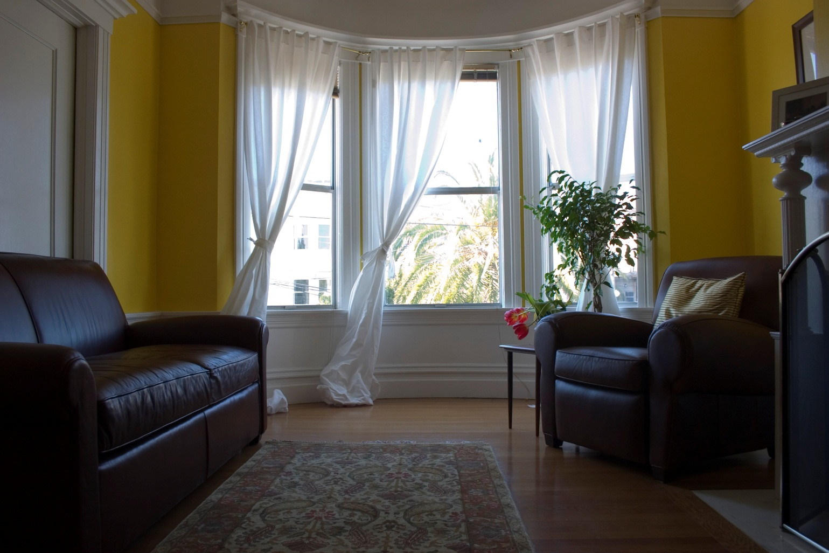
Example: Bracketed Image Set
exposure: 1/20s

Slide 8
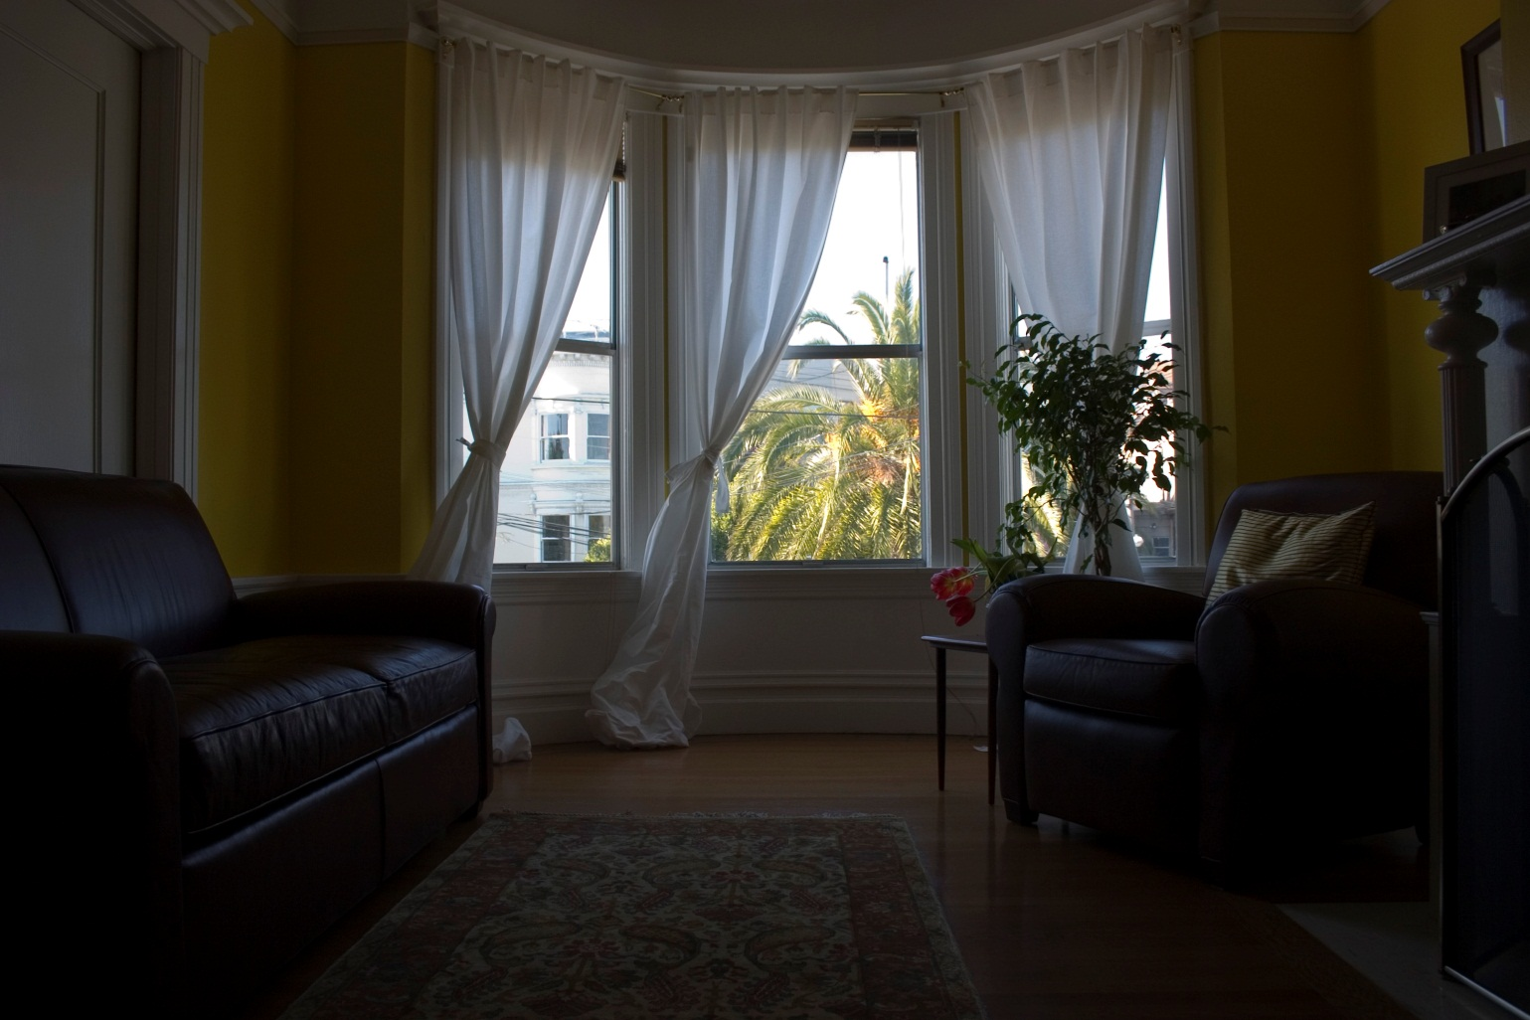
Example: Bracketed Image Set
exposure: 1/60s

Slide 9
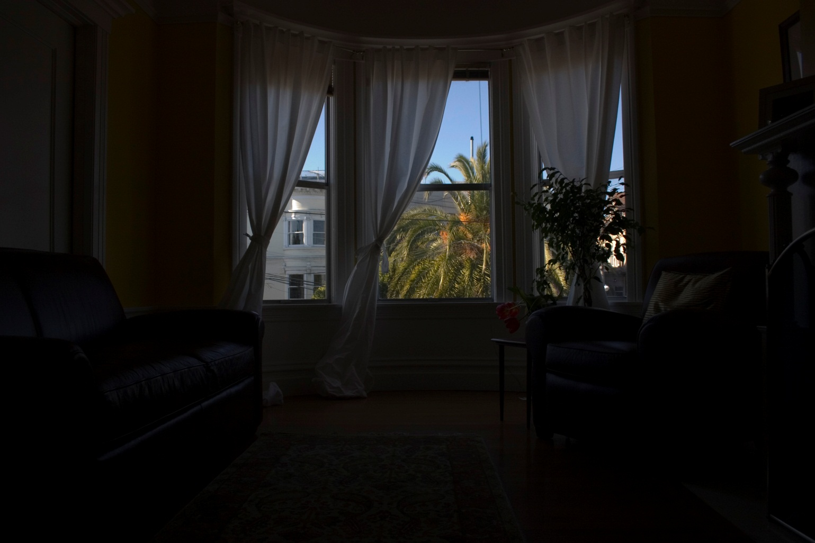
Example: Bracketed Image Set
exposure: 1/250s

Slide 10
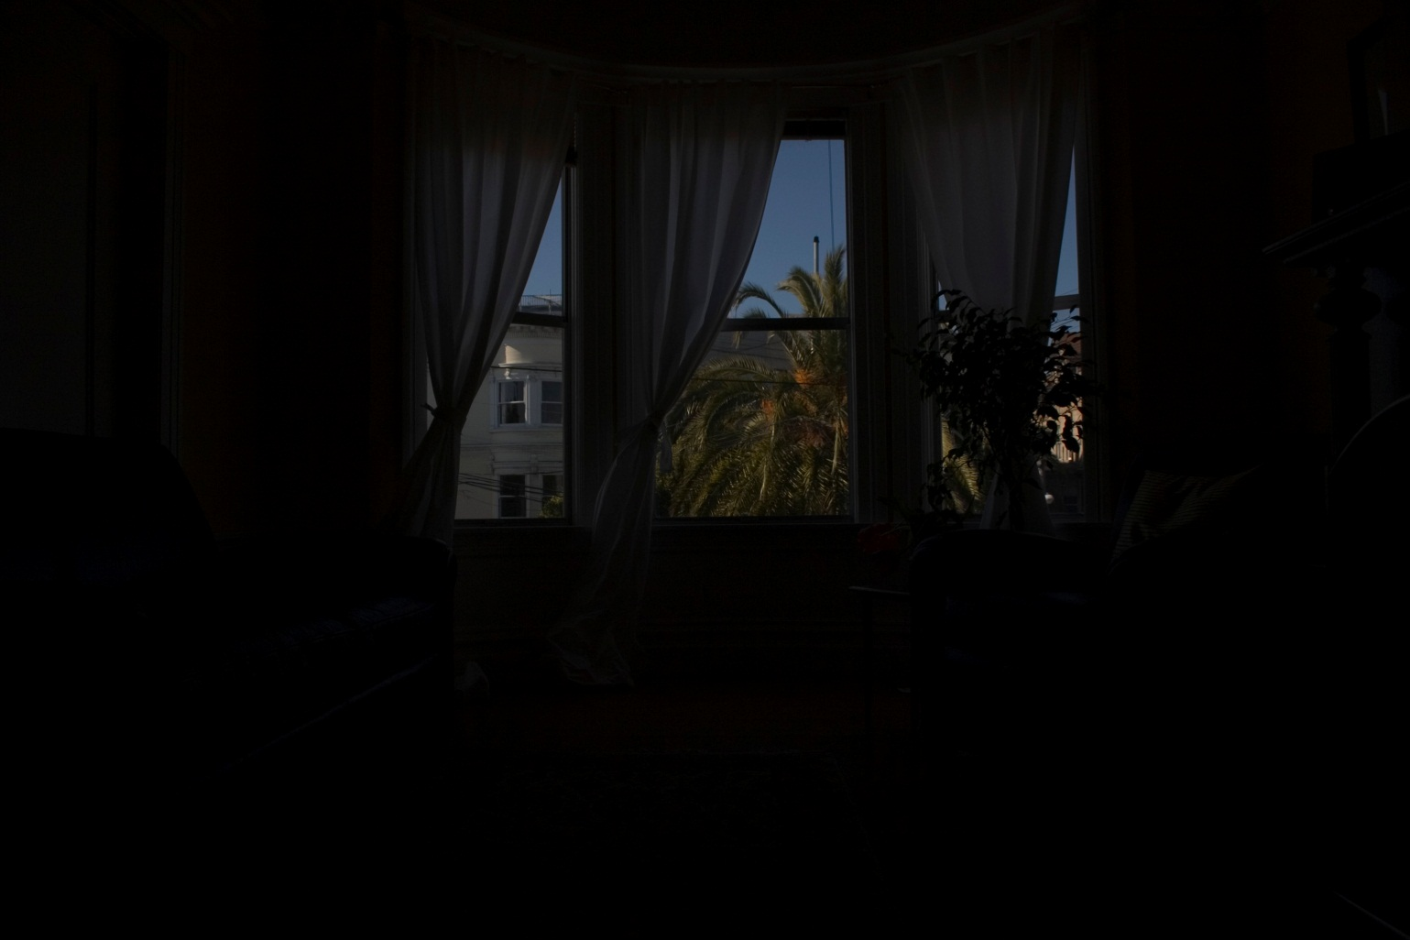
Example: Bracketed Image Set
exposure: 1/1000s

Slide 11
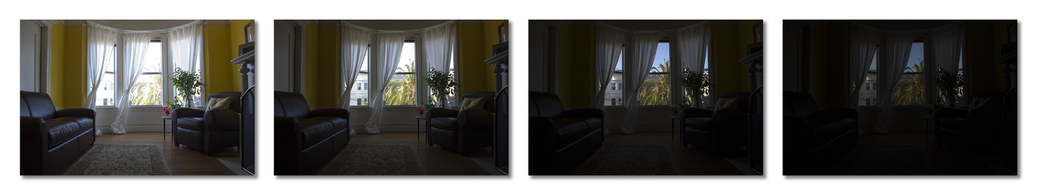
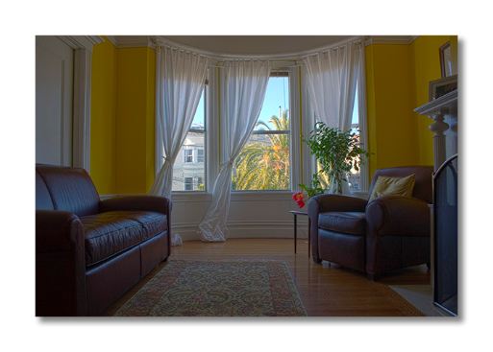
Make an HDR Image from Bracketed Images
Estimate the camera characteristic for each color band.
Remap each band of the BI set through the characteristic.
Tone-map the result of step 2 into a viewable image.

Slide 12
The Camera Characteristic Curve
wavelength of incident radiation,
spectral response of sensing element at pixel p = (r,c),
exposure time of image i from the bracketed image set,
irradiance at pixel p,¹
nonlinear mapping function (characteristic curve), and
numerical value of pixel p in image i.
¹The images are assumed to be taken in succession quickly enough that the scene lighting does not change.

Slide 13
The Camera Characteristic Curve
This is usually simplified by assuming a uniform spectral response so that the equation becomes
exposure time of image i from the bracketed image set,
irradiance at pixel p = (r,c),
nonlinear mapping function (characteristic curve), and
numerical value of pixel p in image i.
Slides 13-21 & 24 were derived from reference [1].

Slide 14
The Camera Characteristic Curve
We can assume that we know both the pixel values and the exposure times for each image in the bracketed image set.
To form an HDR image we must estimate f globally and E at each pixel location p = (r,c). [E is the irradiance map – E_{p} for all p.]
We assume that f is monotonic, therefore invertible, and write
(1)
Take the natural logarithm of both sides to transform multiplication into addition.

Slide 15
The Camera Characteristic Curve
Lump the logarithm with the inverse mapping to define g.
(2)
where
In the equation, Z_{p,i} and Δt_{i} are assumed to be known, E_{p} and g are unknown. But g is assumed to be smooth and monotonic.

Slide 16
Computing the Camera Characteristic Curve
The idea is to recover the g and E_{p} that best satisfy (2) in a least-squared error sense. In a digital image, g can take on only a finite number of values from Z_{min} to Z_{max}.
Let N = R×C be the number of pixels in each image and let M be the number of images.
Then we want to find the Zmax–Zmin+1 values of g(Z) and the N values of ln E_{p} that minimize:²
(3)
²The variable, p, is a linear index through the set of pixels, p.

Slide 17
Computing the Camera Characteristic Curve
The first term of (3) satisfies (2). The second term — the 2nd derivative of g — ensures that g is smooth. Here we let
λ is a Lagrange multiplier. It weights the smoothness term rela-tive to the data fitting term. It was found in [1] that the additional constraint,
causes the midpoint of g to have unit exposure and …

Slide 18
Computing the Camera Characteristic Curve
…that the following intensity weighting function,
(4)
emphasizes the smoothness of g near the middle of the curve. Then (3) becomes:
(5)

Slide 19
Computing the Camera Characteristic Curve
Notes:
Not all pixels need to be used in the minimization. It is sufficient to have N such that N(P–1) > Z_{max}–Z_{min}.
The g found by solving (5) may not be monotonic non-decreasing (MND). It can be forced to be so with a hold function.
We find E = {E_{p} | p  supp(I)} by mapping the pixel values from the bracketed image set through g, weighting them and summing them.
Matlab code is included in [1] and is reproduced on the next pages.

Slide 20
Computing the Camera Characteristic Curve
%
% gsolve.m ̶ Solve for imaging system response function
%
% Given a set of pixel values observed for several pixels in several
% images with different exposure times, this function returns the
% imaging system’s response function g as well as the log film irradiance
% values for the observed pixels.
%
% Assumes:
%
% Zmin = 0
% Zmax = 255
%
% Arguments:
%
% Z(i,j) is the pixel values of pixel location number i in image j
% B(j) is the log delta t, or log shutter speed, for image j
% l is lamdba, the constant that determines the amount of smoothness
% w(z) is the weighting function value for pixel value z
%
% Returns:
%
% g(z) is the log exposure corresponding to pixel value z
% lE(i) is the log film irradiance at pixel location i
Code: Debevec and Malik [1]

Slide 21
Computing the Camera Characteristic Curve
function [g,lE]=gsolve(Z,B,l,w)
n = 256;
A = zeros(size(Z,1)*size(Z,2)+n+1,n+size(Z,1));
b = zeros(size(A,1),1);
%% Include the data-fitting equations
k = 1;
for i=1:size(Z,1)
for j=1:size(Z,2)
wij = w(Z(i,j)+1);
A(k,Z(i,j)+1) = wij; A(k,n+i) = -wij; b(k,1) = wij * B(i,j);
k=k+1;
end
end
%% Fix the curve by setting its middle value to 0
A(k,129) = 1;
k=k+1;
%% Include the smoothness equations
for i=1:n-2
A(k,i)=l*w(i+1); A(k,i+1)=-2*l*w(i+1); A(k,i+2)=l*w(i+1);
k=k+1;
end
%% Solve the system using SVD
x = A\b;
g = x(1:n);
lE = x(n+1:size(x,1));
Code: Debevec and Malik [1]

Slide 22

Example: Sample the Bracketed Image Set
1000 pixel locations are selected at random. Pixel values are taken at the those locations from each band of each image in the bracketed set .
exposure: 1/20s

Slide 23
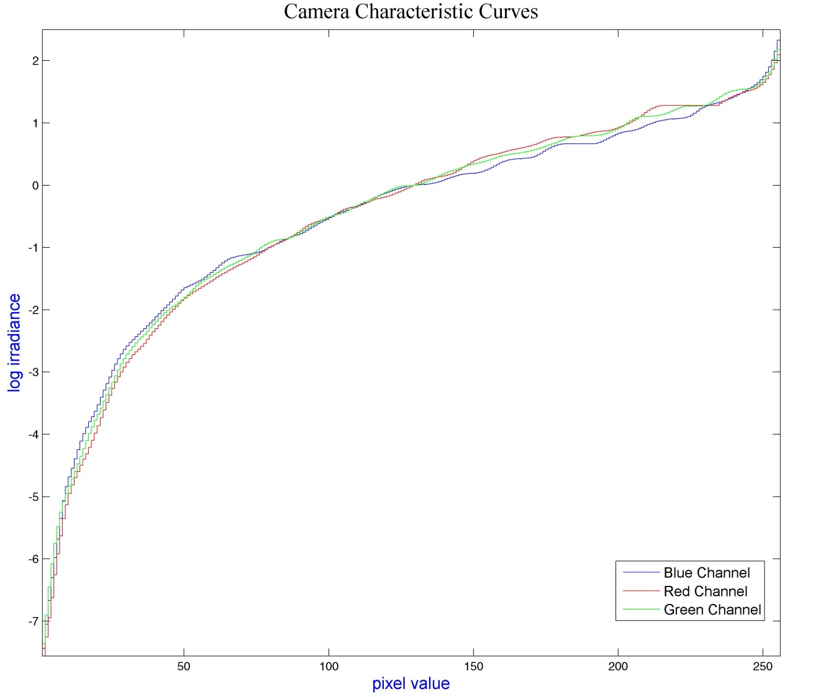
Example: Camera Characteristic Curves
R, G, and B curves Generated using the Debevec and Malik matlab code (pp 20-21), followed by a hold function to make the curves MND.

Slide 24
Constructing the HDR Irradiance Image
From (2) E_{p}, the image irradiance at pixel p, is given by
(6)
Create the log irradiance map by summing from the bracketed image set using
(7)
for each pixel, p.

Slide 25
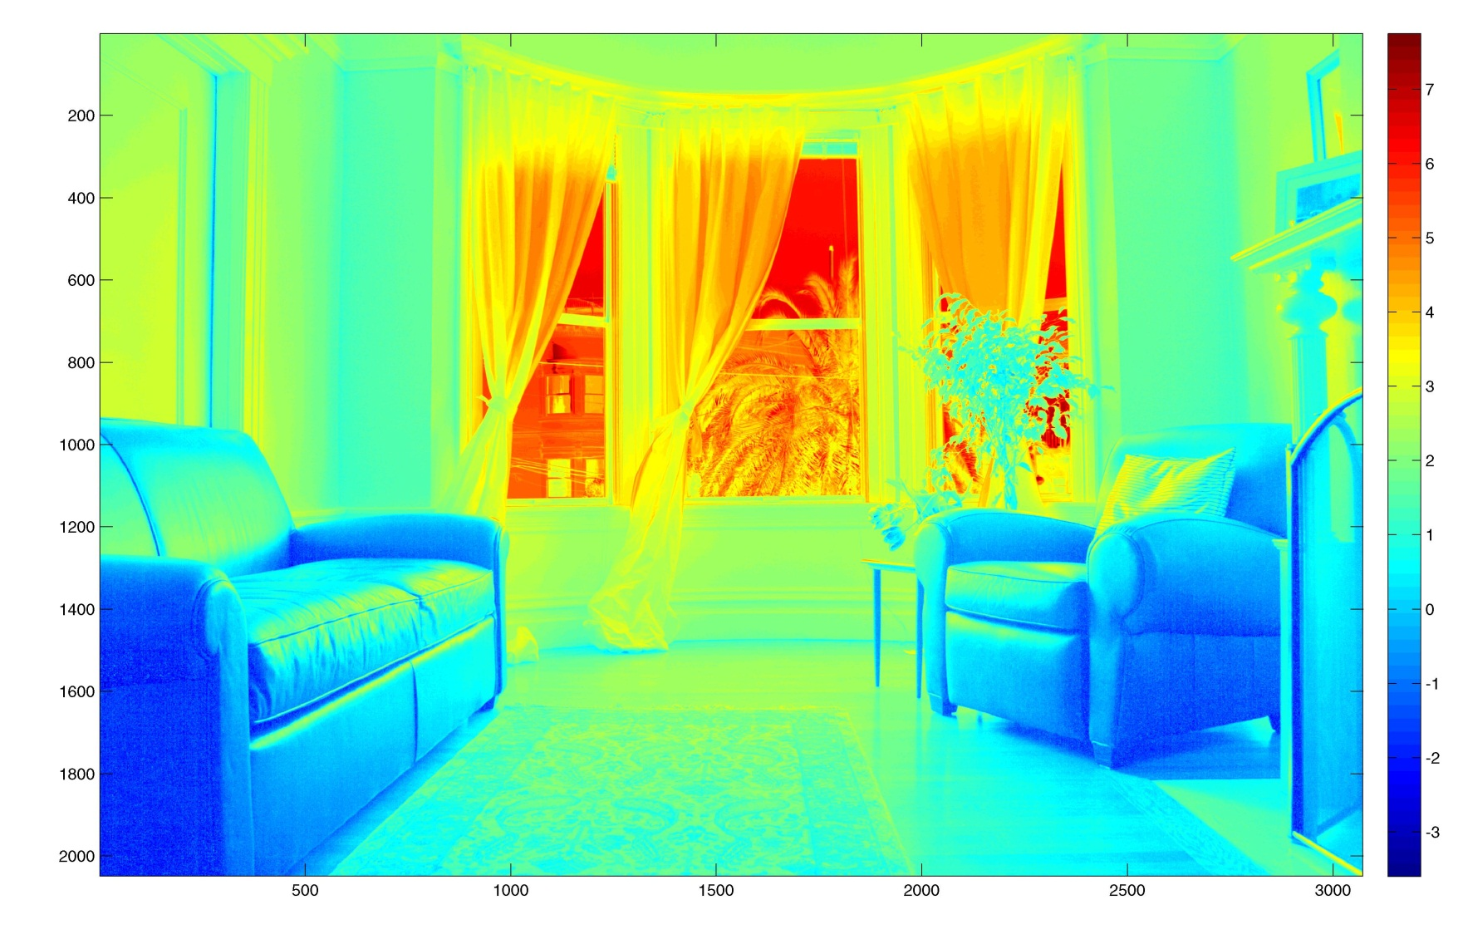
Example: HDR Log Irradiance Map
NTSC weighted luminance of log irradiance map. False color shows the full range of intensities.
L = 0.299E_{red}+0.587E_{green}+0.114E_{blue}
L ← 255{[L-min(L)]/[max(L)-min(L)]}
image(L),colormap(jet(256))

Slide 26
Example: HDR Log Irradiance Map

Slide 27
Original Image, 1/20 s Exposure
exposure: 1/20s

Slide 28
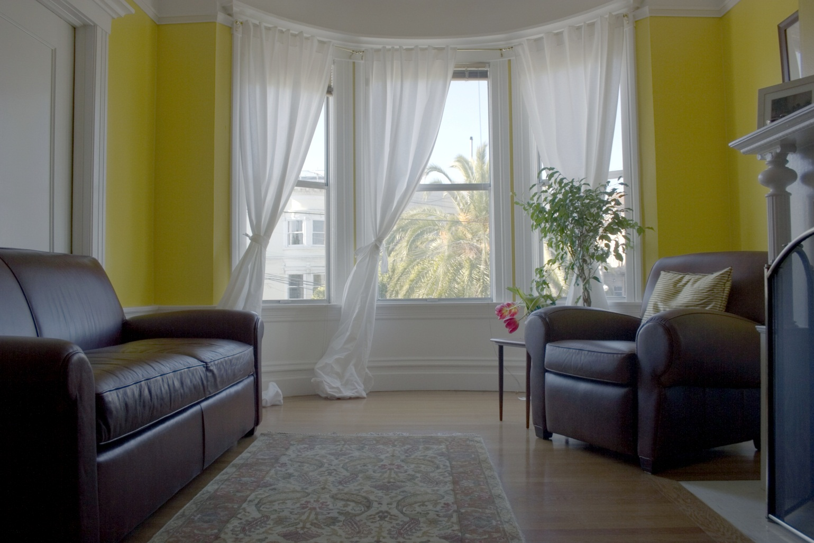
Tonemapped HDR Combination of BI Set
Constructed via (4).

Slide 29
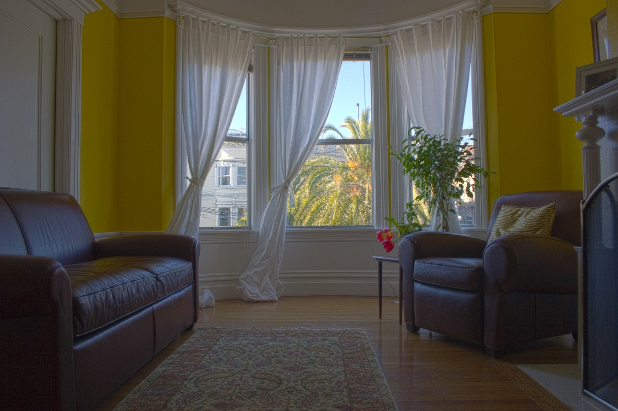
Tonemapped HDR Combination of BI Set
Constructed via Adobe Photoshop CS5 v12.0.4.

Slide 30
Procedure: BI Set → Camera Curves
Load N exposure-bracketed images, I1,…,IN.
Load N exposure times, t(1),…,t(N).
Extract color bands, R1,…,RN, G1,…,GN, B1,…,BN.
Get n≈1000 random cdt pairs(r(j),c(j)) for j=1:n.
Convert coordinates to indices: p = sub2ind(size(R1),r,c).
Let ZR = [R1(p) R2(p) … RN(p)]; size: n×N. Sim: ZG and ZB.
Compute weights, w = [1:128 256-(128:255)];
Make a row vector of the log exposure times, lt = [ln(t(1)) … ln(t(N))];
Replicate it for use by gsolve: T=repmat(lt,[n 1]); size: n×N.
Let smoothness weight l=10; (This is λ,the Lagrange mult.)

Slide 31
Procedure: BI Set → Camera Curves
Solve for the r, g, and b camera characteristics:
[gR,lER]=gsolve(ZR,T,l,w);
[gG,lEG]=gsolve(ZG,T,l,w);
[gB,lEB]=gsolve(ZB,T,l,w);
Make the curves monotone nondecreasing:
mgR=MakeMonotone(gR);
mgG=MakeMonotone(gG);
mgB=MakeMonotone(gB);
Consolide the curves: g=[mgR mgG mgG]; size: 256×3.
Consolidate the images into a cell array: I={I1,I2,…,IN};

Slide 32
Camera Curves → HDR Log Irradiance Image
Construct a log irradiance image, E, using (7) and (4):
[R,C,B] = size(I1);
E = zeros(R,C,B);
for d = 1:3 % for each colorband
gd = g(:,d);
Dn = zeros(R,C); Nm = Dn;
for j = 1:N % for each image in the BI set
Nm = Nm + w(I{j}(:,:,d)+1).*(gd(I{j}(:,:,d)+1)-lt(j));
Dn = Dn + w(I{j}(:,:,d)+1);
end
z = Dn == 0; % find zeros in the denominator
Dn(z) = 1; Nm(z) = 0; % make the output 0 there
E(:,:,d) = Nm./Dn; % log irradiance image
end

Slide 33
HDR → 8-Bit Image: Tone Mapping
The dynamic range of an HDR image is much greater than the 256 levels that a standard digital image can represent and much greater than that of a standard monitor. The conversion of an HDR image to 8-bits requires tone mapping.
This can be done with point operators like a contrast mapping, gamma correction, or histogram remapping. But those results are often not very good.
Better are local operators that remap as a function of the contrast of edges .

Slide 34
HDR → 8-Bit Image: Photoshop Algorithm

Slide 35
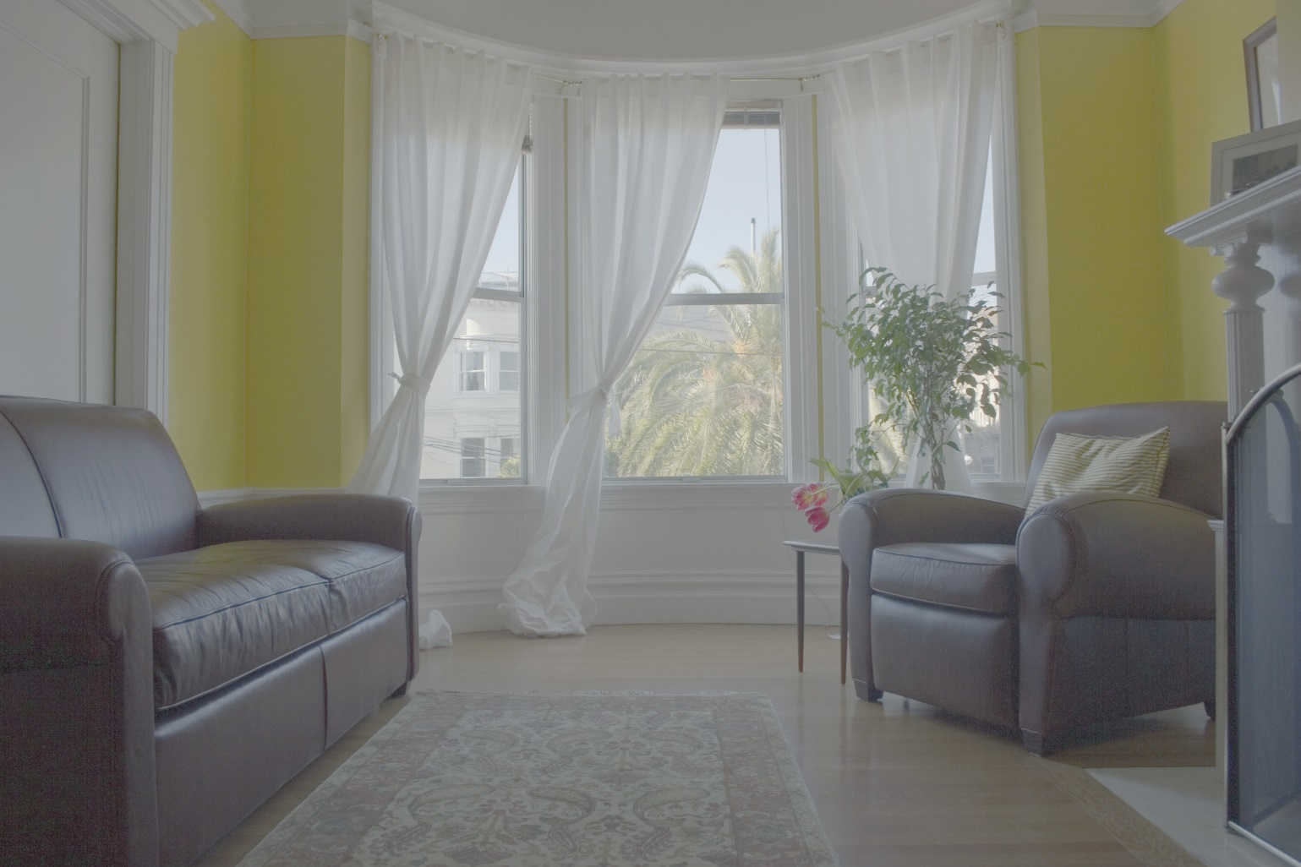
HDR → 8-Bit Image: Linear Contrast Map
I ← 255{[E-min(E)]/[max(E)-min(E)]}

Slide 36
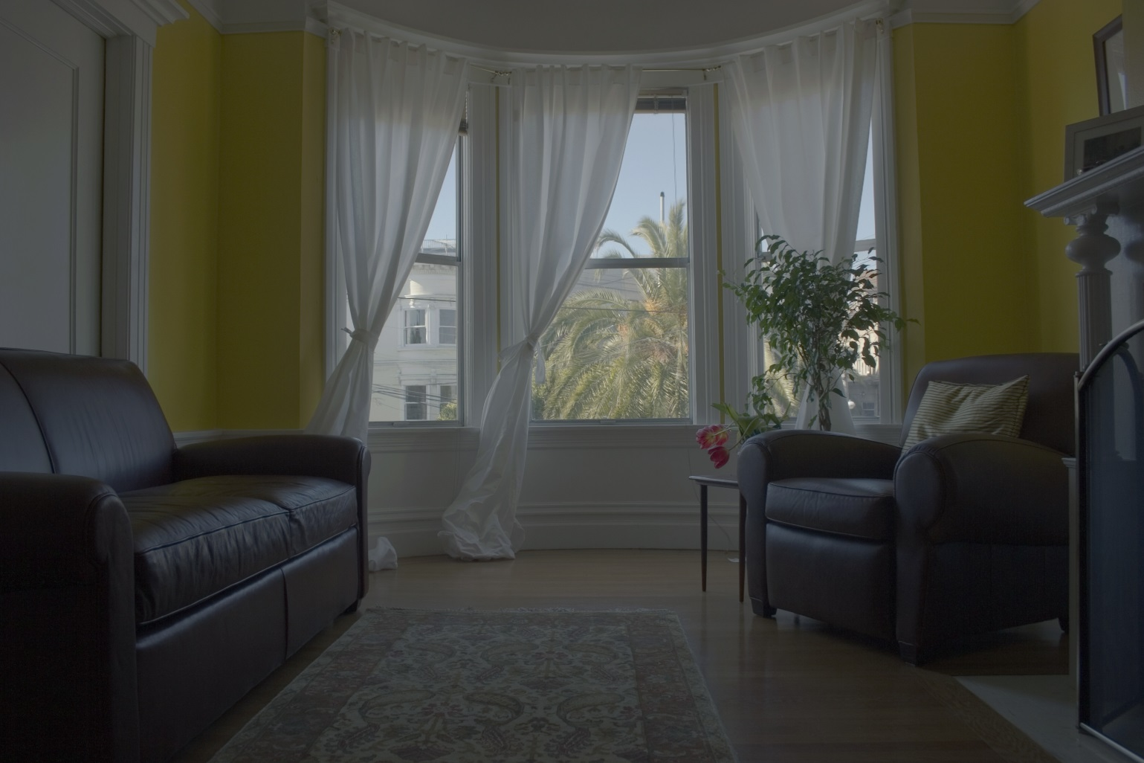
HDR → 8-Bit Image: Gamma Correction
γ = 1/2
I ← 255{([E-min(E)]/[max(E)-min(E)])^{1/γ} }

Slide 37
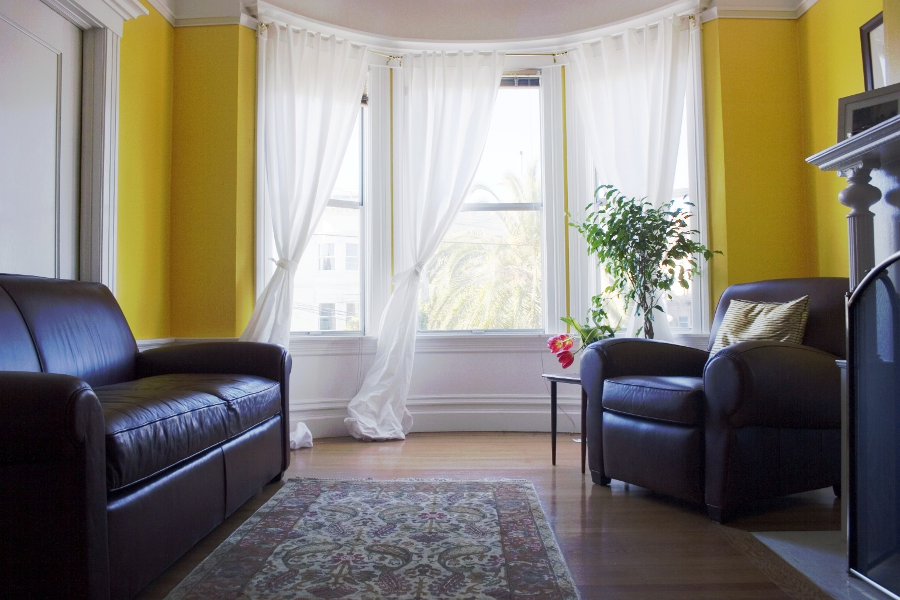
HDR → 8-Bit Image: Histogram EQ
I ← histogram_eq(E)

Slide 38
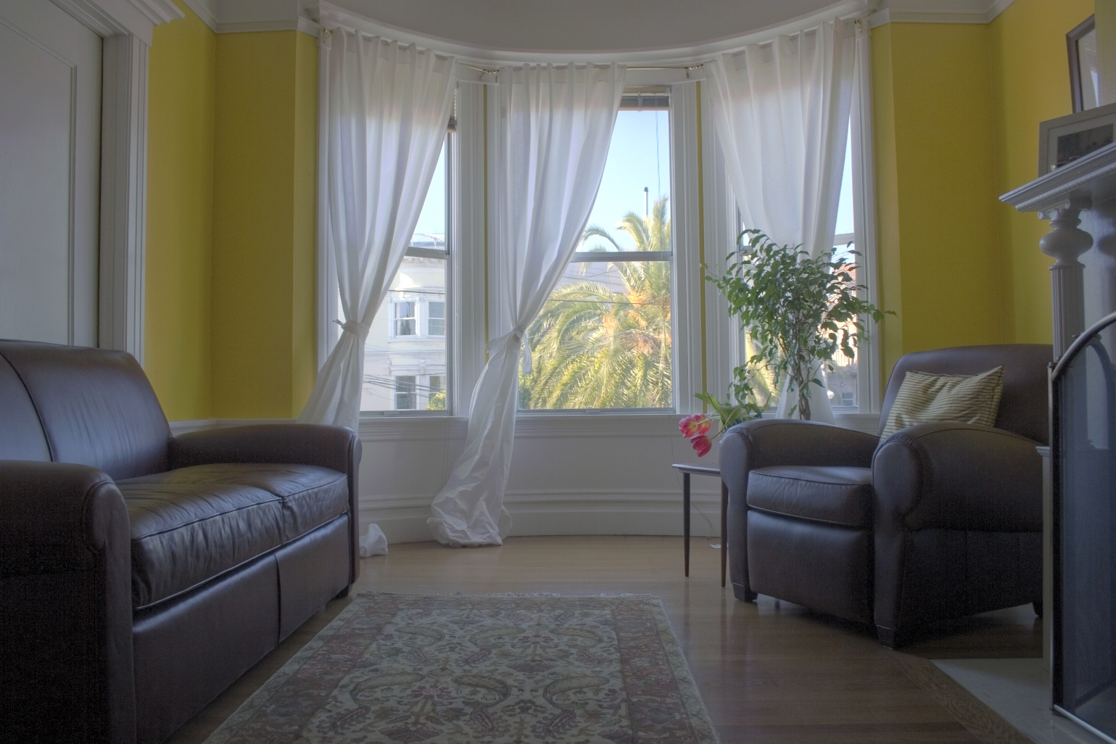
HDR → 8-Bit Image: FLW Algorithm^{1,2}
¹R. Fattal, D. Lischinski, M. Werman, “Gradient domain high dynamic range compression,” In Proceedings of the 29th annual conference on Computer graphics and interactive techniques (SIGGRAPH '02). ACM, New York, NY, USA, 249-256.
²Computed by the freeware open-source program Luminance HDR 2.4.0. (Windows x64 version) URL: http://qtpfsgui.sourceforge.net retrieved 2015-10-29.

